Slide 1
Interconnection Process Enhancements 5.0 Draft Tariff Revisions and Clarifications Matrix
Bill Weaver - Assistant General Counsel - Infrastructure & Rates
Stakeholder meeting
June 1, 2026
ISO Public

Slide 2


Housekeeping
This call is being recorded for informational purposes and will be available on the CAISO website. Any related transcriptions should not be reprinted without the ISO’s permission.
Today’s meeting is designed to encourage open dialogue and diverse perspective. Your participation is valued.
Please engage in a respectful and professional manner.
Please keep comments brief and avoid repeating points already made so we can manage time and ensure everyone has an opportunity to participate.
You can access Closed Captioning and the Transparency Viewer using the controls located at the bottom of the Webex screen.

Slide 3


Instructions for Raising Your Hand to Ask a Question
If you are connected to audio through your computer or used the ‘call me’ option, select the raise hand icon located on the bottom of your screen.
If you are connected on the phone line only and not the Webex dial *3 to be added to the raise hand queue.
Please remember to state your name and affiliation before making your comment.
You may also send question via chat to all panelists.
If you need technical assistance during the meeting, please send a chat to the event producer at Intellor Events.
*3

Slide 4
Today’s Agenda
Time | Topic | Presenter
10:00am – 12:00pm | Welcome and introductions Interconnection Process Enhancements 5.0 -Tariff revisions -RIS Clarifications Matrix Next Steps | Yelena Kopylov-Alford Bill Weaver Yelena Kopylov-Alford
ISO Public

Slide 5
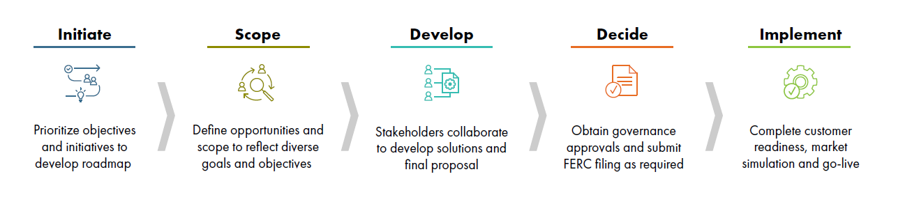

CAISO Policy Initiative Stakeholder Process
2 days
We are here
Learn more in the Stakeholder Process Guide.

Slide 6
Placeholder - Screenshare
ISO Public
Notes:
3.1. Allowing operational Energy Only projects to seek deliverability

Slide 7
Next Steps

Slide 8
IPE 5.0 Schedule
Date | Milestone
May 18, 2026 | Draft tariff revisions and clarifications matrix posted
May 28, 2026 | Comments due
June 6, 2026 | File with FERC
July 2026 | TPD-related tariff revisions posting and meeting
Oct 2026 | Cluster 16 Intake window opens
ISO Public

Slide 9
Next Steps
Comments on the Draft Tariff Language and Clarifications matrix were due on May 28, 2026
Questions? Please email ISOStakeholderAffairs@caiso.com
Additional information on this process is available on the CAISO website at: https://stakeholdercenter.caiso.com/StakeholderInitiatives/Interconnection-process-enhancements-5-0
ISO Public

Slide 10

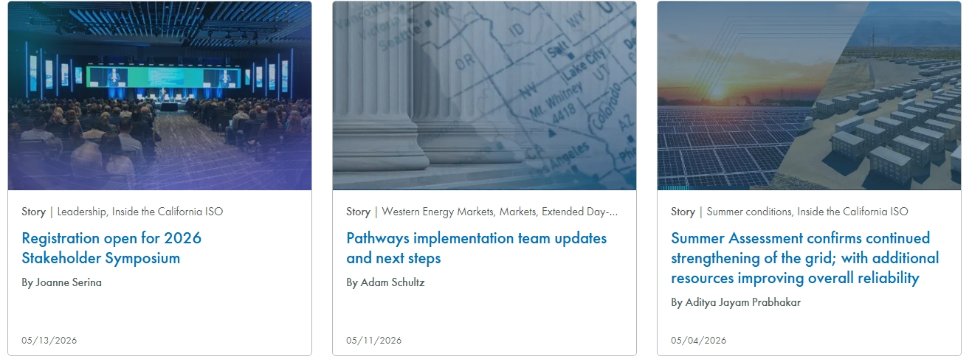
Energy Matters blog provides timely insights into ISO grid and market operations as well as other industry-related news.
https://www.caiso.com/about/news/energy-matters-blog
Subscribe to the Energy Matters blog monthly summary

